Slide 1
UNIT IV BACKTRACKING
Session –27,28 & 29

Slide 2
Syllabus
Introduction - NXN Queen's Problem - Sum of Subsets - Graph Coloring - Hamiltonian's Circuit - Travelling Salesman Problem - Generating Permutation

Slide 3
Introduction to Back tracking
Generalized Algorithm:
Pick a starting point.
while(Problem is not solved)
For each path from the starting point.
check if selected path is safe, if yes select it and make recursive call to rest of the problem
If recursive calls return true, then return true.
else undo the current move and return false.
End For
If none of the move works out, return false, NO SOLUTON.

Slide 4
Hamiltonian Circuit
Let G=(V,E) be a connected graph with n vertices.
A HAMILTONIAN CYCLE is a round trip path along n edges of G which every vertex once and returns to its starting position.
If the Hamiltonian cycle begins at some vertex V1 belongs to G and the vertex are visited in the order of V1,V2…….Vn+1,then the edges are in E, 1<=i<=n and the Vi are distinct except V1 and Vn+1 which are equal.

Slide 5
Consider an example graph G1.
The graph G1 has Hamiltonian cycles:
1,3,4,5,6,7,8,2,1
1,2,8,7,6,5,4,3,1.

Slide 6
Promising (Bounding Functions)
The constraints for a Hamiltonian problem is
The ith vertex in the path must be adjacent to the (i-1)th vertex in any path
The starting and the (n-1)th vertex must be adjacent
The ith vertex can not be one of the first (i-1) vertices

Slide 7
Algorithm
procedure hamiltonian(i)
begin
if promising(i) then
if i=n-1 then
display(v(0..n-1))
end if
else
for j in 2..n loop
v(i+1):=j;
hamiltonian(i+1);
end for;
end if;
End;

Slide 8
Function promising(i)
Begin
Flag=true
For j=1 to i-1 do
if(vertex vi and vj are neighbours)
flag=false
end if
End for
If(vi and vi-1 are neighbours)
flag=true
Else
flag=false
End if
Return (flag)
end

Slide 9
Sample Problem
v₁
v₂
v₃
v₄
1
state space tree
2
5
v₅
v₆
v₇
v₈
5
7
2
6
graph
6
7
3
3
4
8
:
:
3
8
4
:
:

Slide 10
Problem
1 – (2,3,7)
1-2-(1,3,8)
1-2-3-(1,4,6)
1-2-3-4 –(3,5)
1-2-3-4-5 – (4,6)
1-2-3-4-5-6 – (3,5,7)
1-2-3-4-5-6-7-(1,6,8)
1-2-3-4-5-6-7-8 – (2,7) No solution so back track

Slide 11
1-2-3-(1,4,6)
1-2-3-4 –(3,5)
1-2-3-4-5 – (4,6)
1-2-3-4-5-6 – (3,5,7)
1-2-3-4-5-6-7-(1,8)
1-2-3-4-5-6-7-8 – (2,7) No solution so back track

Slide 12
1-2-3-(1,4,6)
1-2-3-6 – (3,5,7)
1-2-3-6-5-(4,6)
1-2-3-6-5-4- (3,5) No solution so back track

Slide 13
Now backtrack
1 – (2,3,7)
1-2- (1,3,8)
1-2-3-(1,4,6)
1-2-3-4 –(3,5)
1-2-3-4-5 – (4,6)
1-2-3-4-5-6 – (3,5,7)
1-2-3-4-5-6-7-(1,8)
1-2-3-4-5-6-7-8 – (2,7) No solution so back track

Slide 14
Now follow
1-(2,3,7)
solution
1-3-4-5-6-7-8-2-1

Slide 15
Generating Permutation
A permutation is a rearrangement of the elements in a list. A string/array of length n has n! permutation.
Input:
An array // [’A’, ‘B’, ‘C’]
Out­put:
[’A’, ‘B’, ‘C’] [’A’, ‘C’, ‘B’], [’B’, ‘A’, ‘C’], [’B’, ‘C’, ‘A’], [’C’, ‘A’, ‘B’], [’C’, ‘B’, ‘A’] OR ABC, ACB, BAC, BCA, CAB, CBA

Slide 16
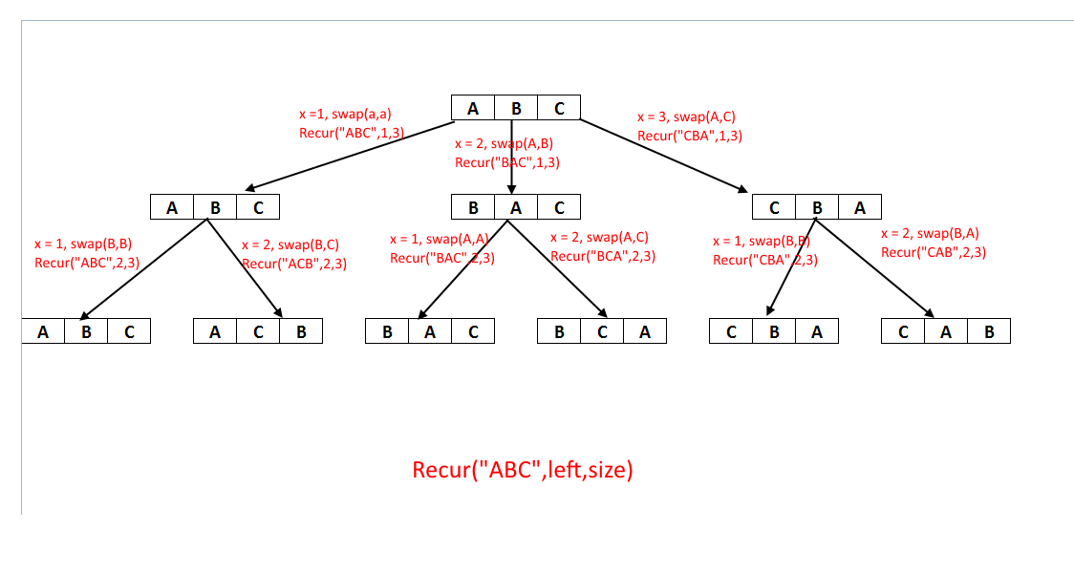

Slide 17
Backtracking algorithm
Iterate over the string one character at a time.
1. Fix a character at the first position and the use swap to put every character at the first position
2. Make recursive call to rest of the characters.
3. Use swap to revert the string back to its original form for next iteration.
Time Complexity: O(n*n!)

Slide 18
Worksheet No. 27, 28 & 29

